Slide 1
FPGA Design Final Project - FIR Filter
電機108 蔡佳凌、曾心妤

Slide 2

8-Tap Even Symmetric Systolic FIR Filter
Mathematic model
$Y\left[n\right]=\sum_{i=0}^{7}{h\left(i\right)∗x\left(i\right)}=\sum_{i=0}^{7}{h\left(i\right)x(7−i)}$
$h\left(i\right)=h(7−i)$

Slide 3
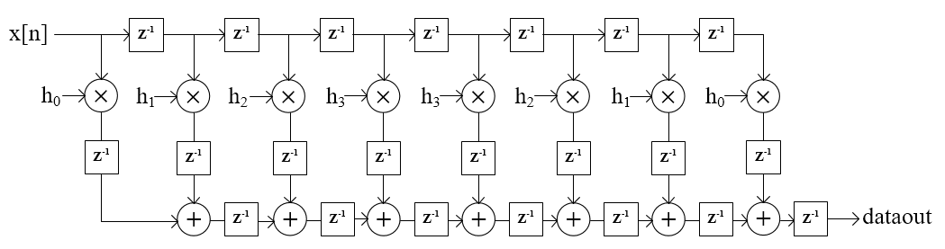
FIR Filter Architecture (initial)

Slide 4
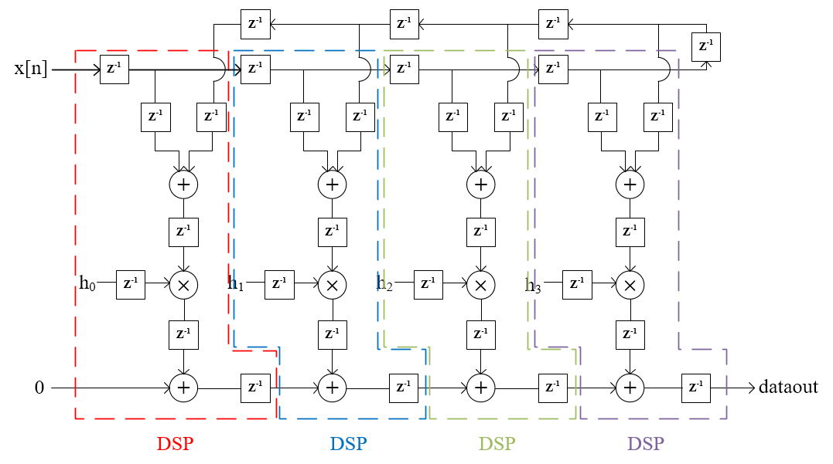
FIR Filter With Pre-adder

Slide 5
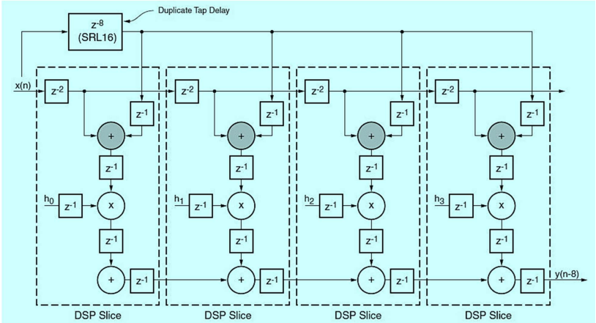
Cutset Retiming of Basic Folded FIR Filter

Slide 6
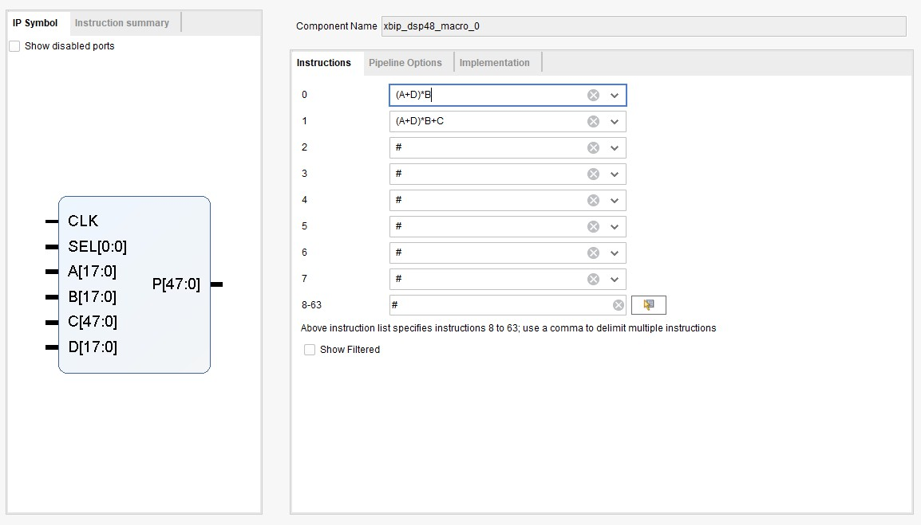
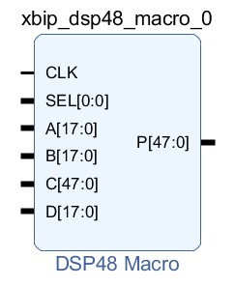
DSP48E1 Macro

Slide 7
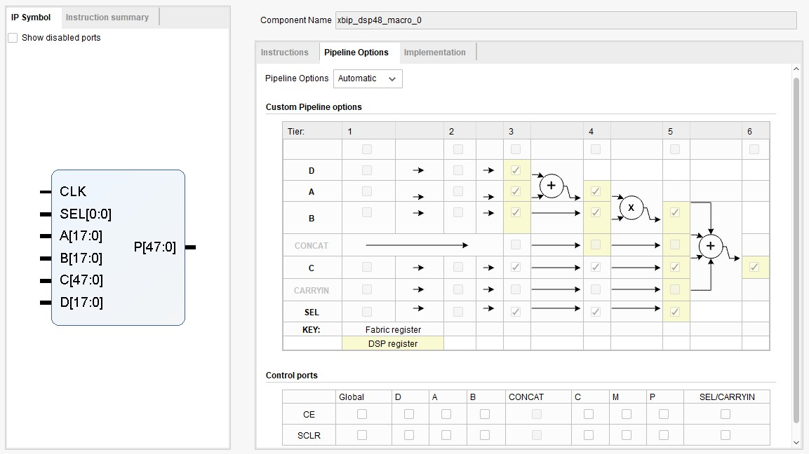
DSP48E1 Macro

Slide 8
Input and Output
Input data X=5,10,12,15,16,1,255,12 (8 bits)
Output data Y (12 bits)
Integer (8 bits)
Fraction (4 bits)

Slide 9
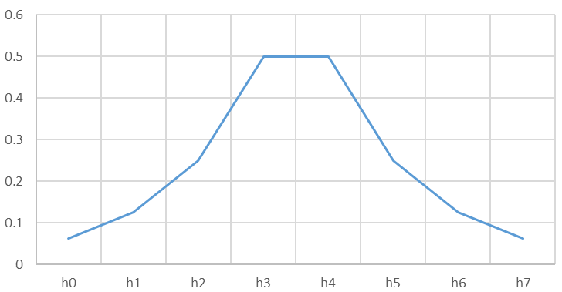
Symmetric Parameter
h0 | h1 | h2 | h3 | h4 | h5 | h6 | h7
0.0625 | 0.125 | 0.25 | 0.5 | 0.5 | 0.25 | 0.125 | 0.0625

Slide 10
Simulation – initial FIR Filter
5x0.0625+10x0.125+12x0.25+15x0.5+16x0.5+1x0.25+255x0.125+12x0.0625
=52.9375 => 00110100.1111

Slide 11
Simulation - FIR Filter With Pre-adder
5x0.0625+10x0.125+12x0.25+15x0.5+16x0.5+1x0.25+255x0.125+12x0.0625
=52.9375 => 00110100.1111

Slide 12
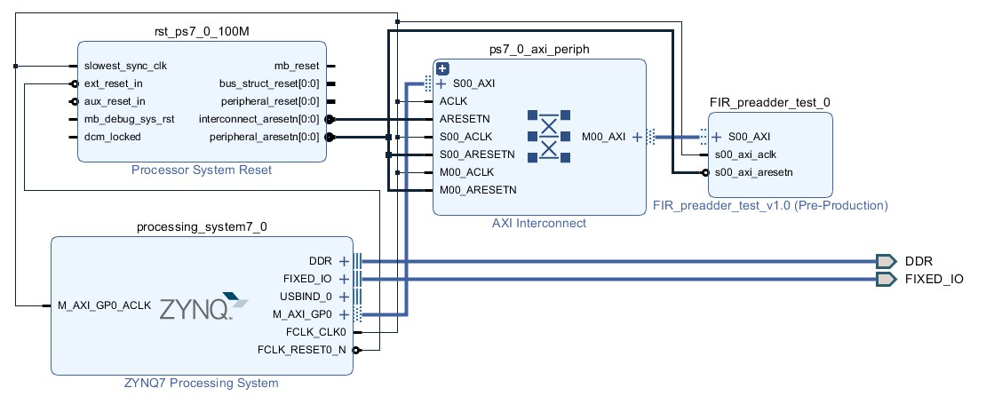
Design Block

Slide 13
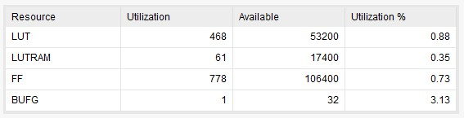
Utilization - initial FIR Filter

Slide 14
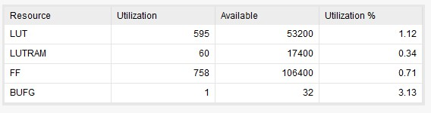
Utilization - FIR Filter With Pre-adder

Slide 15
Discussions
未使用DSP48E1 macro
無法直接接ARM CPU
parameter燒錄問題
PuTTy輸出結果為零
輸入registers有問題
加入divider clk未改善

